Slide 1
Transformer
Decoder
Cross attention

Slide 2

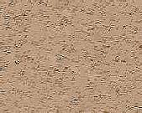
Decoder
output sequence
Encoder
Decoder
Input sequence
( I love machine learning )

Slide 3
Decoder – Autoregressive (AT)
output sequence
Encoder
Decoder
Input sequence
( I love machine learning )

Slide 4

Autoregressive
distribution
Speech Recognition as example
love | 0.0
I | 0.8
deep | 0.0
learning | 0.1
…… | ……
I
I
Size V
max
(common characters)
softmax
Encoder
Decoder
( I love machine learning )
(I love deep learning)
BEGIN (special token)
START

Slide 5
Autoregressive
I
love
deep
learning
I
learning
max
max
max
max
Encoder
Decoder
( I love machine learning )
(I love deep learning)
START
deep
START
I
love

Slide 6
Autoregressive
hate
study
I
love
deep
learning
I
learning
max
Encoder
Decoder
Decoder
Output
( I love machine learning )
(I love deep learning)
study
START
love
START
I
hate
deep

Slide 7
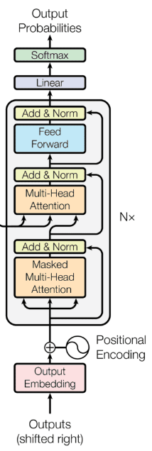
Ignore the input from the encoder here
I
love
deep
learning
I
learning
max
max
max
max
Decoder
START
I
love
machine
START
deep
START
I
love

Slide 8

Encoder
Decoder

Slide 9








Self-attention Masked Self-attention
$$b^{1}$$
$$b^{2}$$
$$b^{3}$$
$$b^{4}$$
$$a^{1}$$
$$a^{2}$$
$$a^{3}$$
$$a^{4}$$
Can be either input or a hidden layer

Slide 10
















Self-attention Masked Self-attention
$$b^{2}$$
$$α_{2,1}^{′}$$
$$α_{2,2}^{′}$$
$$α_{2,3}^{′}$$
$$α_{2,4}^{′}$$
$$q^{1}$$
$$k^{1}$$
$$v^{1}$$
$$q^{2}$$
$$k^{2}$$
$$v^{2}$$
$$q^{3}$$
$$k^{3}$$
$$v^{3}$$
$$q^{4}$$
$$k^{4}$$
$$v^{4}$$
$$a^{1}$$
$$a^{2}$$
$$a^{3}$$
$$a^{4}$$
Why masked?
Consider how does decoder work

Slide 11
Autoregressive
We do not know the correct output length.
Never stop!
love
deep
learning
learning
habit
……
I
class
I
max
max
max
max
max
Encoder
Decoder
( I love machine learning )
(I love deep learning)
START
love
deep
learning
START
I
learning

Slide 12
Adding “Stop Token”
distribution
love | 0.0
I | 0.8
deep | 0.0
learning | 0.1
…… | ……
END | 0.0
Size V
(common characters)
softmax
Encoder
Decoder
( I love machine learning )
(I love deep learning)
START
START

Slide 13
Autoregressive
Stop at here!
love
deep
learning
END
I
I
learning
END
max
max
max
max
max
Encoder
Decoder
( I love machine learning )
(I love deep learning)
START
deep
learning
START
I
love
learning

Slide 14
Decoder – Non-autoregressive (NAT)
output sequence
Encoder
Decoder
Input sequence
( I love machine learning )

Slide 15
AT v.s. NAT
w₁
w₃
w₁
END
w₂
END
w₂
w₃
w₄
AT Decoder
NAT Decoder
START
w₁
w₂
w₃
START
START
START
START
How to decide the output length for NAT decoder?
Another predictor for output length
Output a very long sequence, ignore tokens after
Advantage: parallel, more stable generation
NAT is usually worse than AT

Slide 16
Encoder-Decoder
output sequence
Encoder
Decoder
Input sequence
( I love machine learning )

Slide 17
Encoder
Transformer
Cross attention
Decoder

Slide 18





FC
$$v$$
$$α_{1}^{′}$$
$$α_{2}^{′}$$
$$α_{3}^{′}$$
Cross attention
$$k^{1}$$
$$v^{1}$$
$$k^{2}$$
$$v^{2}$$
$$k^{3}$$
$$v^{3}$$
$$q$$
$$a^{1}$$
$$a^{2}$$
$$a^{3}$$
Encoder
Self-attention (Mask)
START
START

Slide 19


FC
$$v′$$
$$α_{1}^{′}$$
$$α_{2}^{′}$$
$$α_{3}^{′}$$
$$k^{1}$$
$$v^{1}$$
$$k^{2}$$
$$v^{2}$$
$$k^{3}$$
$$v^{3}$$
$$q′$$
$$a^{1}$$
$$a^{2}$$
$$a^{3}$$
Encoder
Self-attention (Mask)
START
I
START

Slide 20
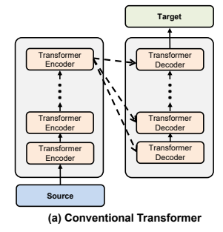
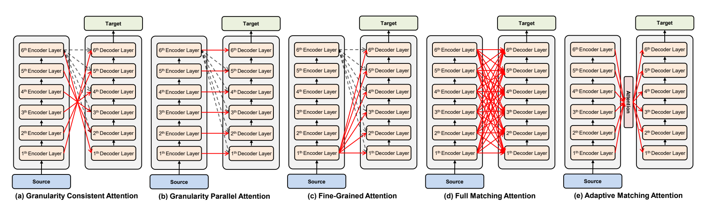
Cross Attention
https://arxiv.org/abs/2005.08081

